Slide 1
University libraries strengthening the academia-society connection through citizen science in the Baltics
(2022-2024)
Dr. Gintarė Tautkevičienė
Library Director
Kaunas University of Technology
https://www.libocs.ut.ee

Slide 2
University libraries strengthening the academia-society connection through citizen science in the Baltics
(2022-2024)
Objectives:
strengthening the role academic libraries can play in Citizen Science activities in the region.
to improve the Citizen Science and Open Science skills of academic and library personnel in the Baltics.
to create institutional change through testing and implementing a citizen science single point of contact in participating LibOCS universities.
https://www.libocs.ut.ee

Slide 3
Librarians as Partners in Citizen Science: Drivers and Barriers
https://www.libocs.ut.ee
Main drivers:
Data management skills
Digital literacy skills
Large network
Library as a physical meeting place
Internal repositories
Established and trusted communication channels
Main barriers:
Lack of knowledge about CS
Lack of knowledge about libraries’ services and potential
Not enough visibility of CS projects
Lack of workforce
Not a priority for universities
Lack of experience and specific skills
Lack of ideas
Notes:
Three online roundtables with
librarians (23)
researchers (19)
students (20)
The main barriers to citizen engagement at research libraries are lack of knowledge, experience, and information about different citizen science projects; lack of ideas and how libraries could be of use; not enough support from universities and policymakers, and people’s perception of how libraries are seen in the 21st century (Kaseorg et al., 2022).
“So I believe that libraries are and always were /…/ like a bridge between researchers, between students, between university administration's, like a bridge. So I believe that academic libraries could also aid in extending communication to the public.”
„The barrier is the engagement of the universities itself. Because we still are a part of universities. So our works are priorities, I mean, dictated by the priorities of the university.“

Slide 4
How to break barriers?
Train librarians on CS and data management
Establish new positions in the library
Appoint a liaison person
Stress the need for stronger support from the university
Establish a central platform for projects and resources
Develop partnership between academic and public libraries
https://www.libocs.ut.ee
“So maybe libraries could turn into certain multifunctional centers, especially in relation to science, you know, having data, giving data, you know, to encourage this participation of citizens in science, in data making and so on. So, definitely, we have to move from one paradigm to another in relation to libraries.“

Slide 5
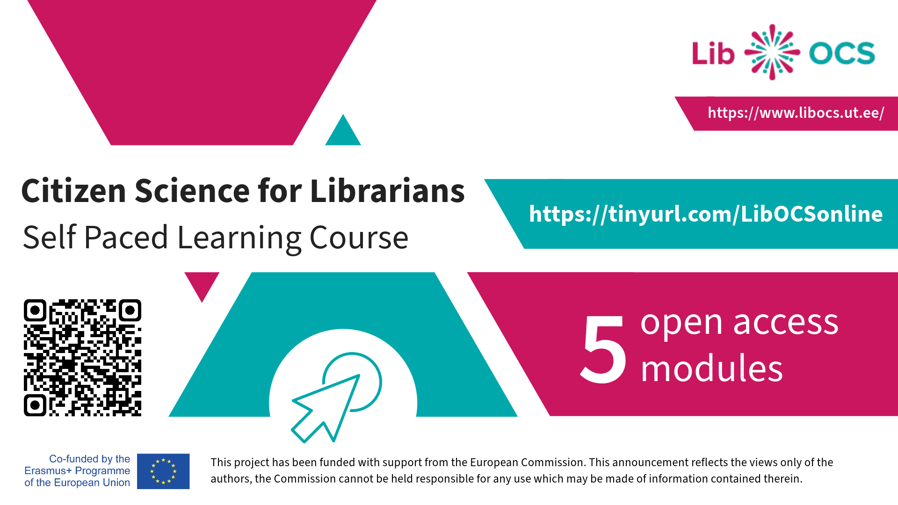
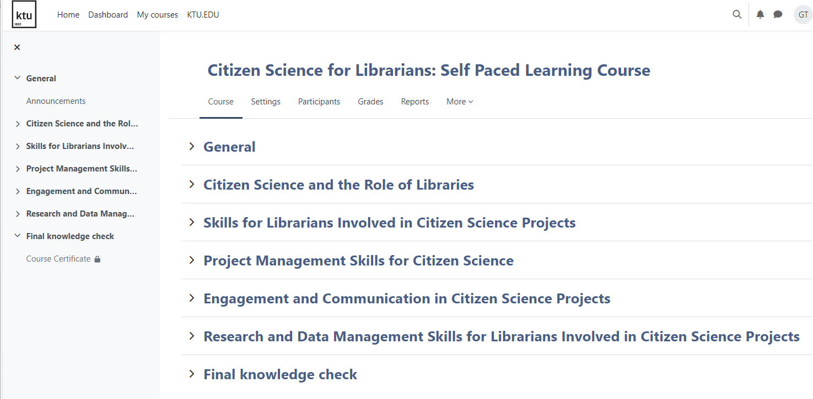
Citizen Science for Librarians: Self Paced Learning Course
https://open.ktu.edu/mod/page/view.php?id=9767

Slide 6
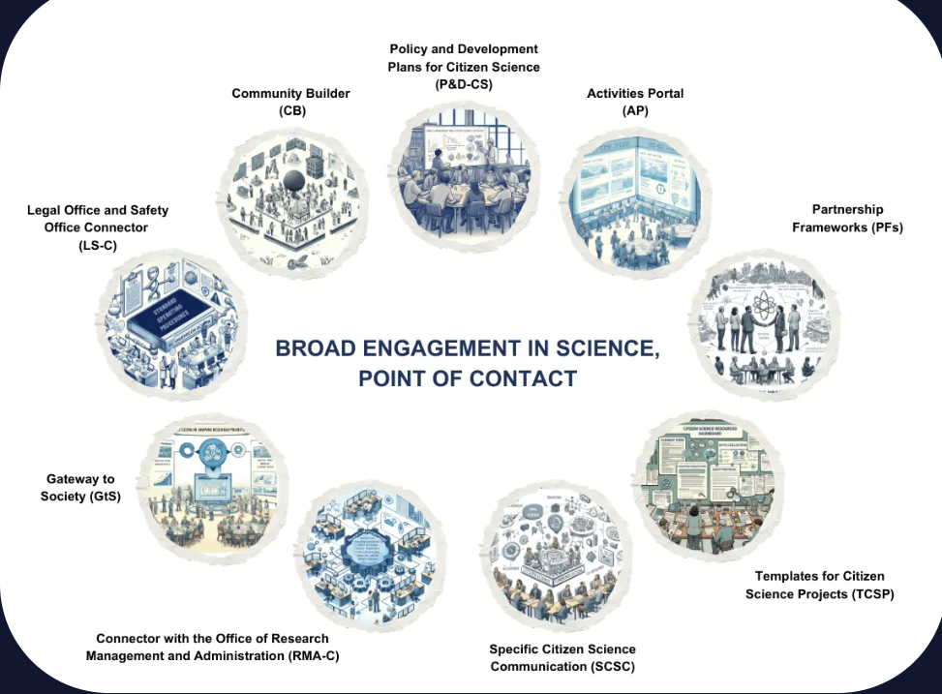
BESPOC Broad Engagement in Science, Point of Contact
Notes:
To enhance the university's commitment to citizen science, a single point of contact (BESPOC) will be established to streamline and support citizen science activities. We outline here the objectives, responsibilities, and guidelines for implementing the BESPOC at the university.
Policy & Development Plans (P&D-CS)
Focuses on developing and updating policies for citizen science.
Aims to institutionalise citizen science in academic settings.
Ensures effective communication and engagement of policies.
Activities Portal (AP)
Serves as a central hub for citizen science projects.
Transforms policies into actionable projects and campaigns.
Supports project engagement, dissemination, and collaboration.
Partnership Frameworks (PFs)
Establishes collaborative relationships with various stakeholders.
Outlines structure, roles, responsibilities, and objectives of partnerships.
Enhances the impact of citizen science in academia and society.
Templates for Citizen Science Projects (TCSP)
Provides resources for initiating and executing citizen science projects.
Includes consent forms, data collection sheets, and safety protocols.
Aids in ethical compliance and effective communication.
Specific Citizen Science Communication (SCSC)
Addresses unique challenges in communicating research to non-professionals.
Promotes accessibility, engagement, and two-way communication.
Fosters transparency and open science principles.
Research Management & Administration Connector (RMA-C)
Integrates citizen science with existing research management systems.
Facilitates efficient workflows and policy integration.
Enhances support for citizen science projects within the university.
Gateway to Society (GtS)
Empower citizens to participate in shaping research priorities.
Ensures research findings are used in policymaking.
Strengthens connections between research and decision-making processes.
Legal & Safety Office Connector (LS-C)
Ensures legal and safety compliance in citizen science projects.
Facilitates understanding and responses to legal and safety matters.
Safeguards participants, researchers, and institutional interests.
Communities Builder (CB)
Cultivates sustainable communities around citizen science projects.
Supports Community of Interest, Knowledge, and Practice.
Encourages personal and collective growth within these communities

